Slide 2








Who is Chad Green
Director of IT Architecture Atria Senior Living / Glennis Solutions
chadgreen@chadgreen.com
TaleLearnCode
ChadGreen.com
ChadGreen & TaleLearnCode
ChadwickEGreen

Slide 3


Slide 4
Azure Cosmos DB
What is Cosmos DB
A globally distributed, massively scalable, multi-model database service

Slide 5

Azure Cosmos DB
A globally distributed, massively scalable, multi-model database service
Turnkey global distribution
Notes:
Turnkey Global Distribution
Enables you to build highly responsive and highly available applications worldwide
Transparently replicates your data wherever your users are, so your users can interact with a replica of the data that is closest to them
Add or remove any of the Azure regions to your Cosmos account at any time, with a click of a button
Cosmos DB will seamlessly replicate your data to all the regions associated with your account while your application continues to be highly available, thanks to the multi-homing capabilities
Always On
By virtue of deep integration with Azure infrastructure and transparent multi-master replication, Cosmos DB provides 99.999% high availability for both reads and writes.
Provides you the ability to programmatically or via Portal invoke the regional failover of your Cosmos account
Helps ensure that your application is designed to failover in the case of regional disaster

Slide 6
Azure Cosmos DB
A globally distributed, massively scalable, multi-model database service
Turnkey global distribution
Notes:
NEXT: Elastic scale out of storage & throughput

Slide 7
Azure Cosmos DB
A globally distributed, massively scalable, multi-model database service
Elastic scale out of storage & throughput
Turnkey global distribution
Notes:
Elastic scalability of throughput and storage, worldwide
Designed with transparent horizontal partitioning and multi-master replication
Offers unprecedent elastic scalability for your writes and reads, all around the globe
Elastically scale up from thousands to hundreds of millions of requests per second around the global with a single API call and pay only for the throughput (and storage) you need
Helps you deal with unexpected spikes in your workloads without having to over-provision for the peak

Slide 8
Azure Cosmos DB
A globally distributed, massively scalable, multi-model database service
Elastic scale out of storage & throughput
Turnkey global distribution
Notes:
NEXT: Guaranteed low latency at the 99th percentile

Slide 9
Azure Cosmos DB
A globally distributed, massively scalable, multi-model database service
Guaranteed low latency at the 99th percentile
Elastic scale out
of storage & throughput
Turnkey global distribution
Notes:
Guaranteed low latency at 99th percentile, worldwide
Using Cosmos DB, you can build highly responsive, planet scale applications
With its novel multi-master replication protocol and latch free and write-optimized database engine, Cosmos guarantees less than 10-ms latencies for both, reads (indexed) and writes at 99th percentile, all around the world
Capability ensures sustained ingestion of data and blazing-fast queries for highly responsive apps

Slide 10
Azure Cosmos DB
A globally distributed, massively scalable, multi-model database service
Guaranteed low latency at the 99th percentile
Elastic scale out
of storage & throughput
Turnkey global distribution
Notes:
NEXT: Five well-defined consistency models

Slide 11
Azure Cosmos DB
A globally distributed, massively scalable, multi-model database service
Five well-defined consistency models
Guaranteed low latency at the 99th percentile
Elastic scale out
of storage & throughput
Turnkey global distribution
Notes:
Strong; Bounded Staleness; Session; Consistent Prefix; Eventual

Slide 12
Azure Cosmos DB
A globally distributed, massively scalable, multi-model database service
Five well-defined consistency models
Guaranteed low latency at the 99th percentile
Elastic scale out
of storage & throughput
Turnkey global distribution
Notes:
Strong; Bounded Staleness; Session; Consistent Prefix; Eventual

Slide 13
Azure Cosmos DB
A globally distributed, massively scalable, multi-model database service
Comprehensive
SLAs
Guaranteed low latency at the 99th percentile
Elastic scale out
of storage & throughput
Five well-defined consistency models
Turnkey global distribution
Notes:
Industry Leading Comprehensive SLAs
First and only service to offer industry-leading comprehensive SLAs encompassing 5-nine availability, read and write latency at the 99th percentile, guaranteed throughput, and consistency.

Slide 14
Azure Cosmos DB
A globally distributed, massively scalable, multi-model database service
Comprehensive
SLAs
Guaranteed low latency at the 99th percentile
Elastic scale out
of storage & throughput
Five well-defined consistency models
Turnkey global distribution

Slide 15


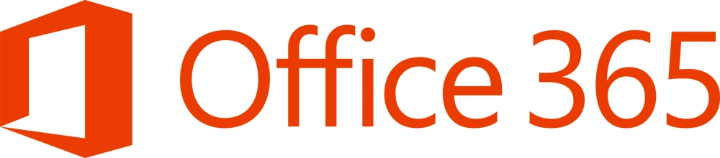

Azure Cosmos DB
A globally distributed, massively scalable, multi-model database service
Battle Tested
Guaranteed low latency at the 99th percentile
Elastic scale out
of storage & throughput
Five well-defined consistency models
Comprehensive
SLAS
Turnkey global distribution
Notes:
Battle tested database service
Cosmos DB is a foundational service in Azure
For nearly a decade, Cosmos DB has been used by many of Microsoft’s products for mission critical applications at global scale
Skype, Xbox, Office 365, Azure, and many others
One of the fastest growing services on Azure

Slide 16











Azure Cosmos DB
Battle Tested
Guaranteed low latency at the 99th percentile
Elastic scale out
of storage & throughput
Five well-defined consistency models
Comprehensive
SLAS
Turnkey global distribution

Slide 17
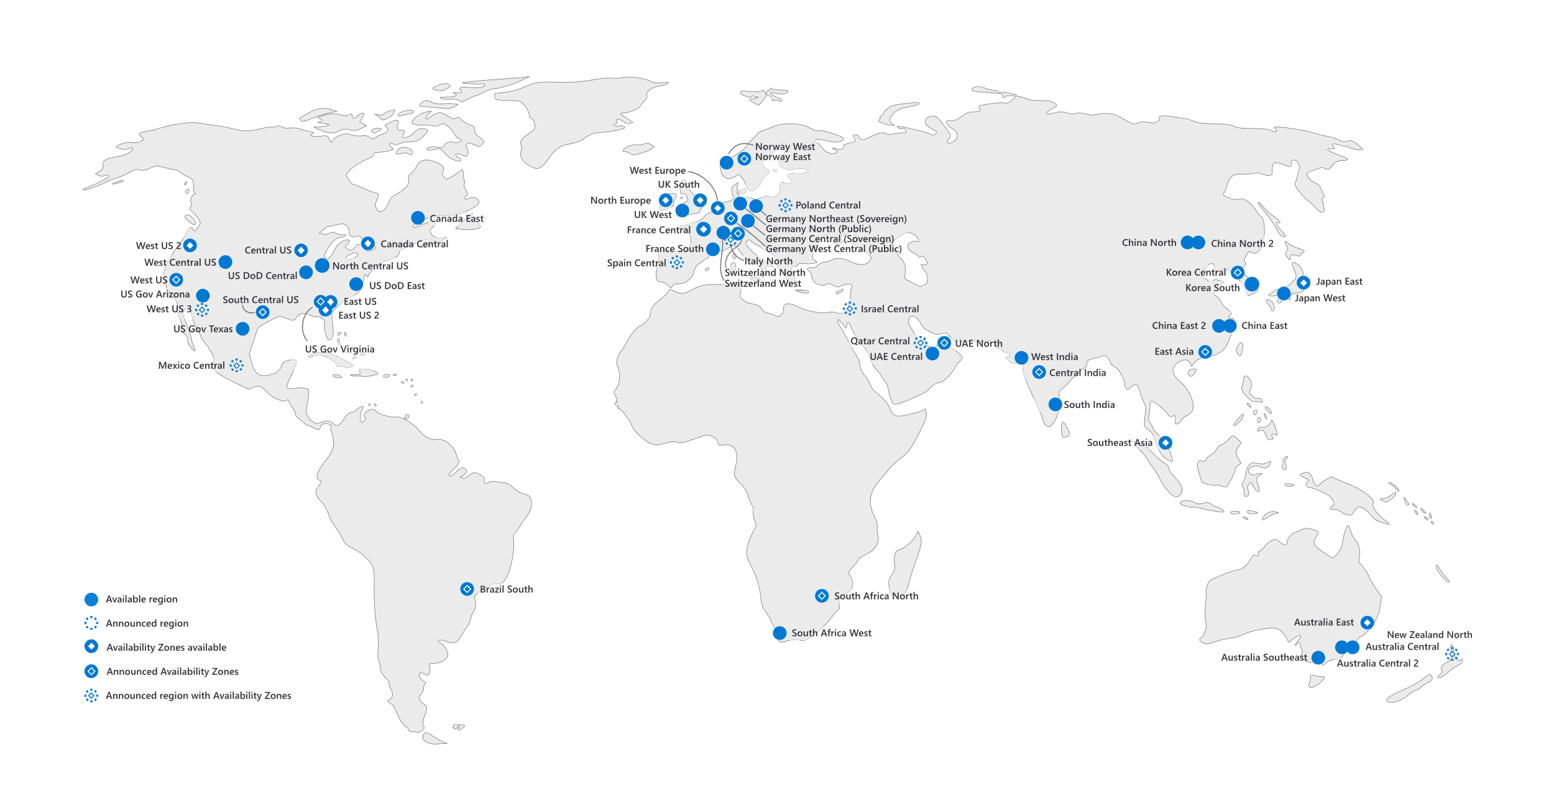
Azure Cosmos DB
A globally distributed, massively scalable, multi-model database service
Ubiquitous Regional Presence
Guaranteed low latency at the 99th percentile
Elastic scale out
of storage & throughput
Five well-defined consistency models
Comprehensive
SLAS
Turnkey global distribution
Notes:
Ubiquitous regional presence
Azure public cloud
Azure China 21Vianet (one of China’s largest internet providers)
Azure Germany (data remains in country)
Azure Government (4 regions)
Azure Government for Department of Defense (2 regions)

Slide 18
Azure Cosmos DB
A globally distributed, massively scalable, multi-model database service
Secure by default and enterprise ready
Guaranteed low latency at the 99th percentile
Elastic scale out
of storage & throughput
Five well-defined consistency models
Comprehensive
SLAS
Turnkey global distribution
Notes:
Secure by default and enterprise ready
Certified for a wide array of compliance standards
CSA STAR Certification\CSA STAR Attestation
ISO 20000-1:2011, 22301:2012, 27001:2013, 27017:2015, 27018:2014
SOC 1,2,3
DoD SRP Level 2
FedRAMP Moderate
GxP
HIPPA
HITRUST
PCI DSS
Australian IREP Unclassifed
Germany C5
Singapore MTCS Level 3
Spain ENS High
Encrypted at rest and in motion
Provides row level authorization and adheres to strict security standards

Slide 19







Azure Cosmos DB
A globally distributed, massively scalable, multi-model database service
Column-family
Document
Key-value
Graph
Guaranteed low latency at the 99th percentile
Elastic scale out
of storage & throughput
Five well-defined consistency models
Turnkey global distribution
Comprehensive SLAs

Slide 20


Slide 21
Elements in an Azure Cosmos DB Account
Provision Azure Cosmos DB Account
Create database in that account
Add containers on those databases
Container can be realized based upon the data API

Slide 22
Elements in an Azure Cosmos DB Account
Provision Azure Cosmos DB Account
Create database in that account
Add containers on those databases
Container can be realized based upon the data API

Slide 23
Elements in an Azure Cosmos DB Account
Provision Azure Cosmos DB Account
Create database in that account
Add containers on those databases
Container can be realized based upon the data API
Items are realized based upon the data API

Slide 24
Elements in an Azure Cosmos DB Account
Provision Azure Cosmos DB Account
Create database in that account
Add containers on those databases
Container can be realized based upon the data API
Items are realized based upon the data API

Slide 25
Elements in an Azure Cosmos DB Account
Provision Azure Cosmos DB Account
Create database in that account
Add containers on those databases
Container can be realized based upon the data API
Items are realized based upon the data API

Slide 26
Azure Cosmos DB Architecture
Atom
Record
Sequence
Notes:
Azure Cosmos DB uses an atom-record-sequence (ARS) system. Basically, the Cosmos DB translates all data models into atom-record-sequence based models.
So, everything becomes either an atom, a record, or a sequence.
An atom is a primitive type.
A record is a struct
A sequence is an array of either atoms, records, or structs.

Slide 27
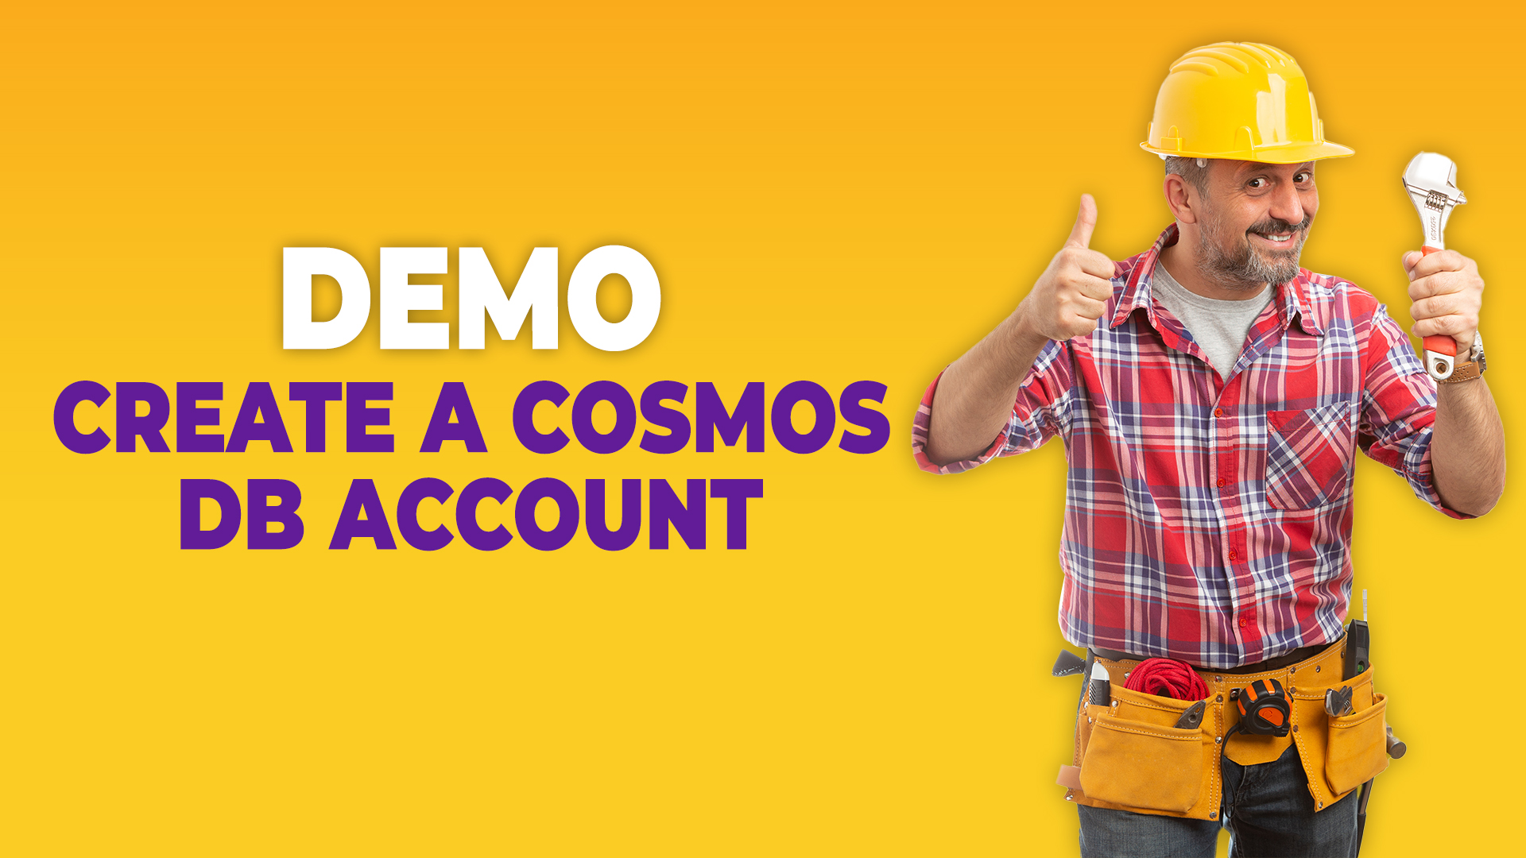

Slide 28


Slide 29
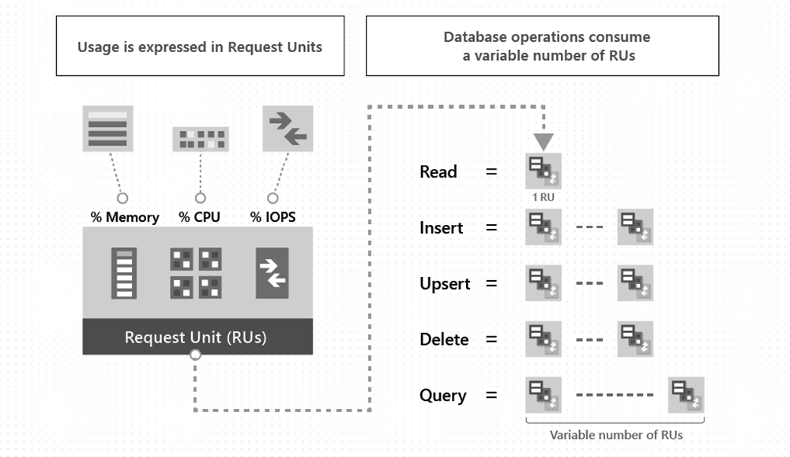
Request Units (RUs)
Notes:
The cost of all database operations is normalized by Azure Cosmos DB and is expressed by Request Units (or RUs for short). Request unit is a performance currency abstracting the system resources such as CPU, IOPs, and memory that are required to perform the database operations supported by Azure Cosmos DB.
The cost to do a point read (i.e. fetching a single item by its ID and partition key value) for a 1-Kb item is 1 RU. All other database operations are similarly assigned a cost using RUs. No matter which API you use to interact with your Azure Cosmos container, costs are always measured by RUs. Whether the database operation is a write, point read, or query, costs are always measured in RUs.
You can examine the response header to track the number of RUs that are consumed by any database operation.

Slide 30
Request Unit Considerations
Item Size
Notes:
While you estimate the number of RUs consumed by your workload, consider the following factors:
Item Size: As the size of an item increases, the number of RUs consumed to read or write the item also increases.

Slide 31

Request Unit Considerations
Item Size
Item Indexing
Notes:
Item Indexing: By default, each item is automatically indexed. Fewer RUs are consumed if you choose not to index some of your items in a container.

Slide 32
Request Unit Considerations
Item Size
Item Indexing
Item Property Count
Notes:
Item Property Count: Assuming the default indexing is on all properties, the number of RUs consumed to write an item increases as the item property count increases.

Slide 33
Request Unit Considerations
Item Size
Item Indexing
Item Property Count
Indexed Properties
Notes:
Indexed Properties: An index policy on each container determines which properties are indexed by default. To reduce the RU consumption for write operations, limit the number of indexed properties.

Slide 34
Request Unit Considerations
Item Size
Item Indexing
Item Property Count
Indexed Properties
Data Consistency
Notes:
Data Consistency: The strong and bounded staleness consistency levels consume approximately two times more RUs while performing read operation when compared to that of other relaxed consistency levels.

Slide 35
Request Unit Considerations
Item Size
Item Indexing
Item Property Count
Indexed Properties
Data Consistency
Type of Reads
Notes:
Types of Reads: Point reads cost significantly fewer RUs than queries.

Slide 36
Request Unit Considerations
Item Size
Item Indexing
Item Property Count
Indexed Properties
Data Consistency
Type of Reads
Query Patterns
Notes:
Query patterns: The complexity of a query affects how many RUs are consumed for an operation. Factors that affect the cost of query operations include:
The number of query results
The number of predicates
The nature of the predicates
The number of user-defined functions
The size of the source data
The size of the result set
Projections
The same query on the same data will always cost the same number of RUs on repeated executions.

Slide 37
Request Unit Considerations
Item Size
Item Indexing
Item Property Count
Indexed Properties
Data Consistency
Type of Reads
Query Patterns
Script Usage
Notes:
Script Usage: As with queries, stored procedures and triggers consume RUs based on the complexity of the operations that are performed. As you develop your application, inspect the request charge header to better understand how much RU capacity each operation consumes.

Slide 38
Estimate RU Costs
Operation | Estimated Costs
Create an item | 5 RUs
Update an item | 10 RUs
Read an item (point read) | 1 RU
Delete an Item | 5 RUs
Execute a query | 10 RUs

Slide 39
Operational RU Costs
Operation | Estimated Cost | Notes
Create an item | 5 RUs | Average cost for a 1-Kb item with less than 5 properties to index
Update an item | 10 RUs | Average cost for a 1-Kb item with less than 5 properties to index
Read an item (point-read) | 1 RU | Average cost for a 1-Kb item
Delete an item | 5 RUs
Execute a query | 10 RUs | Average cost for query that takes full advantage of indexing and returns 100 results or less

Slide 40


Slide 41
Partitioning
Logical Partitions
Notes:
A logical partition consists of a set of items that have the same partition key.
For example, in a container that contains data about food nutrition, all items contain a foodGroup property. You can use foodGroup as the partition key for the container. Group of items that have specific values for foodGroup, such as Beef Products, Baked Products, and Sausages and Luncheon Meats, form distinct logical partitions.
There is no limit to the number of logical partitions in your container. Each logical partition can store up to 20Gb of data.

Slide 42
Partitioning
Logical Partitions
Physical Partitions
Notes:
A container is scaled by distributing data and throughput across physical partitions. Internally, one or more logical partitions are mapped to a single physical partition. Typically smaller containers have many logical partitions but they only require a single physical partition. Unlike logical partitions, physical partitions are an internal implementation of the system and they are entirely managed by Azure Cosmos DB.
The number of physical partitions in your container depends on the following:
The number of throughput provisioned (each individual physical partition can provide a throughput of up to 10,000 request unites per second).
The total data storage (each individual physical partition can store up to 50-Gb of data)
There is no limit to the total number of physical partitions in your container. As your provisioned throughput or data size grows, Azure Cosmos DB will automatically create new physical partitions by splitting existing ones. Physical partition splits do not impact your application’s availability. After the physical partition split, all data within a single logical partition will still be stored on the same physical partition. A physical partition split simply creates a new mapping of logical partitions to physical partitions.

Slide 43
Choosing a partition key
Unchanging Property Value
Notes:
For all containers, your partition key should:
Be a property that has a value which does not change. If a property is your partition key, you cannot update that property’s value.

Slide 44
Choosing a partition key
Unchanging Property Value
High Cardinality
Notes:
Have a high cardinality. In other words, the property should have a wide range of possible values.

Slide 45
Choosing a partition key
Unchanging Property Value
High Cardinality
Spreads RU Consumption
Notes:
Spread request unit (RU) consumption and data storage evenly across all logical partitions. This ensures even RU consumption and storage distribution across your physical partitions.
Some additional considerations for read-heavy containers

Slide 46
Choosing a partition key
Unchanging Property Value
High Cardinality
Spreads RU Consumption
Common Filter
Notes:
For large read-heavy containers, however, you might want to choose a partition key that appears frequently as a filter in your queries.
However, if your container is small, you probably do not have enough physical partitions to need to worry about the performance impact of cross-partition queries. Most small containers in Azure Cosmos DB only require one or two physical partitions.
Your container will require more than a few physical partitions when either of the following are true:
Your container will have over 30,000 RU’s provisioned
Your container will store over 100-Gb of data

Slide 47
Using Item Id as the Partition Key
Wide Range of Possible Values
Balances RU Consumption
Point Reads Become Easier
Notes:
The item Id is a great partition key choice for the following reasons:
There are a wide range of possible values (one unique item Id per item)
Because there is a unique item Id per item, the item Id does a great job at evenly balancing RU consumption and data storage
You can easily do efficient point reads since you will always know an item’s partition key if you know it’s item Id
Some things to consider when selecting the item Id as the partition key include:

Slide 48
Using Item Id as the Partition Key
Wide Range of Possible Values
Balances RU Consumption
Point Reads Become Easier
Partition key will become unique identifier
Should have an equality filter with the item Id
Stored Procedures/Triggers Cannot Run Across Multiple Partitions
Notes:
Some things to consider when selecting the item Id as the partition key include:
If the Item Id is the partition key, it will become a unique identifier throughout your entire container
If you have a read-heavy container that has a lot of physical partitions, queries will be more efficient if they have an equality filter with the item Id.
You cannot run stored procedures or triggers across multiple logical partitions

Slide 49


Slide 50
Provisioning – The Basics
Database Provisioning
Notes:
Set Throughput on a Database
When you provision throughput on an Azure Cosmos database, the throughput is shared across all the containers in the database.
Sharing the database-level provisioned throughput among its containers is analogous to hosting a database on a cluster of machines. Because all containers within a database share the resources available on a machine, you naturally do not get predictable performance on any specific container.
Because all containers within the database share the provisioned throughput, Azure Cosmos DB does not provide any predictable throuhgpout guarantees for a particular container in that database. The portion of the throughput that a specific container can receive is dependent on:
The number of containers
The choice of partition keys for various containers
The distribution of the workload across various logical partitions of the containers
Containers in a shared throughput database share the throughput allocated to that database. You can have up to four containers with a minimum of 400 RU/s on the database. With standard (manual provisioned throughput, each new container after the first four will require an additional 100 RU/s minimum.
Maximum of 25 containers in a shared throughput database, which better enables throughput sharing across the containers. After the first 25 containers, you can add more containers to the database only if they are provisioned with dedicated throughput, which is separate from the shared throughput of the database.
With autoscale provisioned throughput, you can have up to 25 containers in a database with autoscale max 4000 RU/s (scales between 400 – 4000 RU/s).

Slide 51
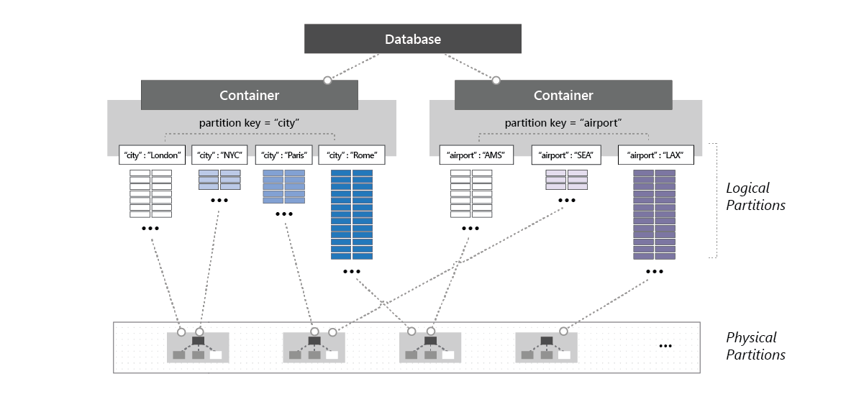
Provisioning – The Basics
Database Provisioning
Database Provisioning
Notes:
This image shows how a physical partition can host one or more logical partitions that belong to different containers within a database..

Slide 52
Provisioning – The Basics
Database Provisioning
Container Provisioning
Notes:
Set throughput on a container
The throughput provisioned on an Azure Cosmos container is exclusively reserved for that container. The container receives the provisioned throughput all the time.
The throughput provisioned for a container is evenly distributed among its physical partitions, and assuming a good partition key that distributes the logical partitions evenly among the physical partitions, the throughput is also distributed evenly across all the logical partitions of the container.
You cannot selectively specify the throughput for logical partitions. Because one or more logical partitions of a container are hosted by a physical partition, the physical partitions belong exclusively to the container and support the throughput provisioned on the container.
Microsoft recommends that you configure throughput at the container granularity when you want predictable performance for the container.

Slide 53

Provisioning – The Basics
Database Provisioning
Container Provisioning
Container Provisioning
Notes:
This image shows how a physical partition hosts one or more logical partitions of a container.

Slide 54
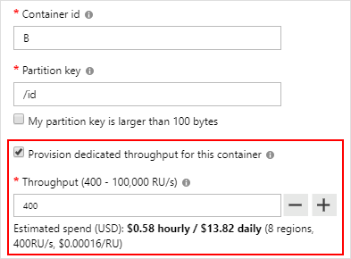
Provisioning – The Basics
Database Provisioning
Container Provisioning
Combination
Notes:
Set throughput on a database and a container
You can combine the two models. Provisioning throughput on both the database and the container is allowed.

Slide 55
Provisioning – Autoscale
Notes:
In Azure Cosmos DB, you can configure either standard (manual) or autoscale provisioned throughput on your database and containers. Autoscale provisioned throughput allows you to scale the throughput of your database or container automatically and instantly. The throughput is scaled based on the usage, without impacting the availability, latency, throughput, or performance of the workload.
Autoscale provisioned throughput is well suited for mission-critical workloads that have variable or unpredictable traffic patterns, and require SLAs on high performance and scale.
Minimum threshold is 10% of the maximum threshold.
Entry point for autoscale maximum throughput starts at 4000 RU/s
Because scaling is automatic and instantaneous, at any point in time, you can consume up to the provisioned max with no delay

Slide 56
Provisioning – Autoscale Benefits
Simple
Notes:
Simple: Autoscale removes the complexity of managing RU/s with custom scripting or manually scaling capacity.

Slide 57
Provisioning – Autoscale Benefits
Simple
Scalable
Notes:
Scalable: Databases and containers automatically scale the provisioned throughput as needed. There is no distribution to client connections, applications, or impact to Azure Cosmos DB SLAs.

Slide 58
Provisioning – Autoscale Benefits
Simple
Scalable
Cost-Effective
Notes:
Cost-effective: Autocale helps optimize your RU/s usage and cost usage by scaling down when not in use. You only pay for the resources that your workloads need on a per-hour basis.
Of all hours in a month, if you set autoscale max RU/s and use the full amount for 66% of the hours or less, you’ll save with autoscale.

Slide 59
Provisioning – Autoscale Benefits
Simple
Scalable
Cost-Effective
Highly Available
Notes:
Highly Available: Databases and containers using autoscale use the same globally distributed, fault-tolerant, highly available Azure Cosmos DB backend to ensure data durability and high availability.

Slide 60
Provisioning – Autoscale Use Cases
Variable/Unpredictable Workloads
Notes:
Variable or unpredictable workloads: When your workloads have variable or unpredictable spikes in usage, autoscale helps by automatically scaling up and down based on usage.
Retail websites that have different traffic patterns depending on seasonality
IOT workloads that have spikes at various times during the day
Line of business applications that see peek usage a few times a month or year
With autoscale, you no longer need to manually provision for peak or average capacity.

Slide 61
Provisioning – Autoscale Use Cases
Variable/Unpredictable Workloads
New Applications
Notes:
New applications: If you are developing a new application and now sure about the throughput you need, autoscale makes it easy to get started. You can start with autoscale entry point of 400 – 4000 RU/s, monitor your usage, and determine the right RU/s over time.

Slide 62
Provisioning – Autoscale Use Cases
Variable/Unpredictable Workloads
New Applications
Infrequently Used Applications
Notes:
Infrequently used applications: If you have an application that is only used for a few hours several times a day, week, or month – such as a low-volume application/web/blog site – autoscale adjusts the capacity to handle peak usage and scales down when it’s over.

Slide 63
Provisioning – Autoscale Use Cases
Variable/Unpredictable Workloads
New Applications
Infrequently Used Applications
Development and Test Workloads
Notes:
Development and test workloads: If you or your team uses Azure Cosmos databases and containers during work hours, but do not need them on nights or weekends, autoscale helps save cost by scaling down to a minimum when not in use.

Slide 64
Provisioning – Autoscale Use Cases
Variable/Unpredictable Workloads
New Applications
Infrequently Used Applications
Development and Test Workloads
Scheduled Production Workloads/Queries
Notes:
Scheduled production workloads/queries: If you have a series of scheduled requests, operations, or queries that you want to run during idle periods, you can do that easily with autoscale. When you need to run the workloads, the throughput will automatically scale to what is needed and scale down afterward.

Slide 65
Provisioning – Autoscale Use Cases
Variable/Unpredictable Workloads
New Applications
Infrequently Used Applications
Development and Test Workloads
Scheduled Production Workloads/Queries
Notes:
Building a custom solution to these problems not only requires an enormous amount of time, but also introduces complexity in your application’s configuration or code. Autoscale enable these scenarios out of the box and removes the need for custom or manual scaling of capacity.

Slide 66
Provisioning – Autoscale Use Cases
Variable/Unpredictable Workloads
New Applications
Infrequently Used Applications
Development and Test Workloads
Scheduled Production Workloads/Queries
Notes:
Let’s look at two of these situations; you could still potentially be charged more than you want/need to be
Is there something better – YES (maybe)

Slide 67
Provisioning – Serverless
Provisioned Throughput
Guarantee Based Billing
Notes:
In provisioned throughput mode, you have to commit to a certain amount of throughput that is provisioned on your databases and containers. The cost of your database options is then deducted from the number of Request Units available every second. At the end of your billing period, you get billed for the amount of throughput you have provisioned.

Slide 68
Provisioning – Serverless
Preview
Provisioned Throughput
Guarantee Based Billing
Serverless Throughput
Consumption Based Billing
Notes:
In serverless mode, you do not have to provision any throughput when creating containers in your Azure Cosmos account. At the end of your billing period, you get billed for the number of Request Units that were consumed by your database operations.

Slide 69
Provisioning – Serverless Performance
Availability
Notes:
Serverless resources yield specific performance characteristics that are different from what provisioned throughput resources deliver. (Once the service goes GA).
Availability: The availability of serverless containers will be covered by SLA of 99.9% when Availability Zones are not used. The SLA is 99.99% when Availability Zones are used.

Slide 70
Provisioning – Serverless Performance
Availability
Latency
Notes:
Latency: The latency of serverless will be covered by a Service Level Objective (SLO) of 10 milliseconds or less for point-reads and 30 milliseconds or less for writes.

Slide 71
Provisioning – Serverless Performance
Availability
Latency
Burstability
Notes:
Burstability: The Burstability of serverless containers will be covered by a Service Level Objective (SLO) of 95%. This means the maximum Burstability can be attained at least 95% of the time.

Slide 72
Provisioning – Serverless Use Cases
Light Traffic
Notes:
Light traffic: Because provisioning capacity in such situations is not required and may be cost-prohibitive

Slide 73
Provisioning – Serverless Use Cases
Light Traffic
Moderate Burstability
Notes:
Moderate Burstability: Because serverless containers can deliver up to 5,000 Request Units per second

Slide 74
Provisioning – Serverless Use Cases
Light Traffic
Moderate Burstability
Moderate Performance
Notes:
Moderate Performance: Because serverless containers have specific performance characteristics

Slide 75
Provisioning – Serverless Use Cases
Light Traffic
Moderate Burstability
Moderate Performance
Notes:
For these reasons, Azure Cosmos DB serverless should be considered for the certain types of workloads

Slide 76
Provisioning – Serverless Use Cases
Light Traffic
Moderate Burstability
Moderate Performance
Development
Testing
Prototyping
Proof of concept
Non-critical application with light traffic
Notes:
For these reasons, Azure Cosmos DB serverless should be considered for the certain types of workloads:
Development
Testing
Prototyping
Proof of concept
Non-critical application with light traffic

Slide 77
Provisioning – Serverless Limitations
Single Region
Notes:
Single Region: A serverless account can only run in a single Azure region. It is not possible to add additional Azure regions to a serverless account after you create it.

Slide 78
Provisioning – Serverless Limitations
Single Region
Synapse Link Unavailable
Notes:
It is not possible to enable the Synapse Link feature on a serverless account.
Azure Synapse Link for Azure Cosmos DB is a cloud-native hybrid transactional and analytical processing (HTAP) capability that enables you to run near real-time analytics over operational data in Azure Cosmos DB.
Synapse Link is in preview.

Slide 79
Provisioning – Serverless Limitations
Single Region
Synapse Link Unavailable
Unable to Specify RU Provisioning
Notes:
Provisioning throughput is not required on serverless containers, so the following statements are applicable:
You cannot pass any throughput when creating a serverless container and doing so returns an error
You cannot read or update the throughput on a serverless container and doing so returns an error
You cannot create a shared throughput database in a serverless account and doing so returns an error

Slide 80
Provisioning – Serverless Limitations
Single Region
Synapse Link Unavailable
Unable to Specify RU Provisioning
Max of 5,000 RU/s
Notes:
Serverless containers can deliver a maximum throughput Burstability of 5,000 Request Unites per second.

Slide 81
Provisioning – Serverless Limitations
Single Region
Synapse Link Unavailable
Unable to Specify RU Provisioning
Max of 5,000 RU/s
Maximum of 50-Gb Storage
Notes:
Serverless containers can store a maximum of 50-Gb of data and indexes.

Slide 82
Provisioning – Serverless Limitations
Single Region
Synapse Link Unavailable
Unable to Specify RU Provisioning
Max of 5,000 RU/s
Maximum of 50-Gb Storage
Core (SQL) API Only
Notes:
Serverless is currently supported on the Azure Cosmos DB Core (SQL) API only.

Slide 83
Provisioning – Serverless Limitations
Single Region
Synapse Link Unavailable
Unable to Specify RU Provisioning
Max of 5,000 RU/s
Maximum of 50-Gb Storage
Core (SQL) API Only
Unable to migrate to/from
Notes:
Migrating existing accounts to/from serverless mode is not currently supported.

Slide 84
Provisioning – Serverless Limitations
Single Region
Synapse Link Unavailable
Unable to Specify RU Provisioning
Preview
Max of 5,000 RU/s
Maximum of 50-Gb Storage
Core (SQL) API Only
Unable to migrate to/from

Slide 85
Provisioning – Choosing
Criteria | Provisioned | Serverless
Status | Generally Available | In Preview

Slide 86
Provisioning – Choosing
Criteria | Provisioned | Serverless
Status | Generally Available | In Preview
Best Suited For | Mission-critical workloads requiring predictable performance (and cost) | Small-to-medium non-critical workloads with light traffic

Slide 87
Provisioning – Choosing
Criteria | Provisioned | Serverless
Status | Generally Available | In Preview
Best Suited For | Mission-critical workloads requiring predictable performance (and cost) | Small-to-medium non-critical workloads with light traffic
Limitations per Account | Unlimited Azure regions | Limited to one Azure region

Slide 88
Provisioning – Choosing
Criteria | Provisioned | Serverless
Status | Generally Available | In Preview
Best Suited For | Mission-critical workloads requiring predictable performance (and cost) | Small-to-medium non-critical workloads with light traffic
Limitations per Account | Unlimited Azure regions | Limited to one Azure region
Limitations per Container | Unlimited throughput Unlimited storage | Maximum of 5,000 RU/s Maximum of 50-Gb Storage

Slide 89
Provisioning – Choosing
Criteria | Provisioned | Serverless
Status | Generally Available | In Preview
Best Suited For | Mission-critical workloads requiring predictable performance (and cost) | Small-to-medium non-critical workloads with light traffic
Limitations per Account | Unlimited Azure regions | Limited to one Azure region
Limitations per Container | Unlimited throughput Unlimited storage | Maximum of 5,000 RU/s Maximum of 50-Gb Storage
Availability Guarantee | 99.99% to 99.999% | 99.9 to 99.99%

Slide 90
Provisioning – Choosing
Criteria | Provisioned | Serverless
Status | Generally Available | In Preview
Best Suited For | Mission-critical workloads requiring predictable performance (and cost) | Small-to-medium non-critical workloads with light traffic
Limitations per Account | Unlimited Azure regions | Limited to one Azure region
Limitations per Container | Unlimited throughput Unlimited storage | Maximum of 5,000 RU/s Maximum of 50-Gb Storage
Availability Guarantee | 99.99% to 99.999% | 99.9 to 99.99%
Latency Guarantee | < 10-ms for point-reads and writes (SLA) | < 10-ms for point-reads and < 30-ms for writes (SLO)

Slide 91
Provisioning – Choosing
Criteria | Provisioned | Serverless
Status | Generally Available | In Preview
Best Suited For | Mission-critical workloads requiring predictable performance (and cost) | Small-to-medium non-critical workloads with light traffic
Limitations per Account | Unlimited Azure regions | Limited to one Azure region
Limitations per Container | Unlimited throughput Unlimited storage | Maximum of 5,000 RU/s Maximum of 50-Gb Storage
Availability Guarantee | 99.99% to 99.999% | 99.9 to 99.99%
Latency Guarantee | < 10-ms for point-reads and writes (SLA) | < 10-ms for point-reads and < 30-ms for writes (SLO)
Throughput Guarantee | 99.99% (SLA) | 95% Burstability (SLO)

Slide 92
Provisioning – Choosing
Criteria | Provisioned | Serverless
Status | Generally Available | In Preview
Best Suited For | Mission-critical workloads requiring predictable performance (and cost) | Small-to-medium non-critical workloads with light traffic
Limitations per Account | Unlimited Azure regions | Limited to one Azure region
Limitations per Container | Unlimited throughput Unlimited storage | Maximum of 5,000 RU/s Maximum of 50-Gb Storage
Availability Guarantee | 99.99% to 99.999% | 99.9 to 99.99%
Latency Guarantee | < 10-ms for point-reads and writes (SLA) | < 10-ms for point-reads and < 30-ms for writes (SLO)
Throughput Guarantee | 99.99% (SLA) | 95% Burstability (SLO)
Billing Model | Per-hour basis for RU/s provisioned, regardless of how many RUs consumed | Per-hour bases for the amount of RUs consumed by your database operations

Slide 93
Provisioning – Choosing
Burstability
Expected Consumption
Notes:
Might not be as clear as you want; some things to consider:
Your workload’s burstability requirement, that is what is the maximum amount of RUs you may need to consume in one second
Your overall expected consumption, that is what is the total number of RUs you may consume over a month
Let’s look at some costing examples

Slide 94
Provisioning – Choosing
Burstability
Expected Consumption
Notes:
Might not be as clear as you want; some things to consider:
Your workload’s burstability requirement, that is what is the maximum amount of RUs you may need to consume in one second
Your overall expected consumption, that is what is the total number of RUs you may consume over a month
Let’s look at some costing examples

Slide 95
Provisioning – Choosing
Burstability
Expected Consumption
Workload expected to burst to a maximum of 500 RU/s and consume a total of 20,000,000 RUs over a month
Provisioned | Serverless
$29.20 | $5.00
Notes:
Example 1: A workload is expected to burst to a maximum of 500 RU/s and consume a total of 20,000,000 RUs over a month.
In provisioned throughput mode, you would provision a container with 500 RU/s for a monthly cost of $0.008 * 5 * 730 = $29.20
In serverless mode, you would pay for the consumed RUs: $0.25 * 20 = $5.00

Slide 96
Provisioning – Choosing
Burstability
Expected Consumption
Workload is expected to burst to a maximum 500 RU/s and consume a total of 250,000,000 RUs over a month.
Provisioned | Serverless
$29.20
$62.50
Notes:
Example 1: A workload is expected to burst to a maximum of 500 RU/s and consume a total of 250,000,000 RUs over a month.
In provisioned throughput mode, you would provision a container with 500 RU/s for a monthly cost of $0.008 * 5 * 730 = $29.20
In serverless mode, you would pay for the consumed RUs: $0.25 * 250 = $62.50

Slide 97


Slide 98
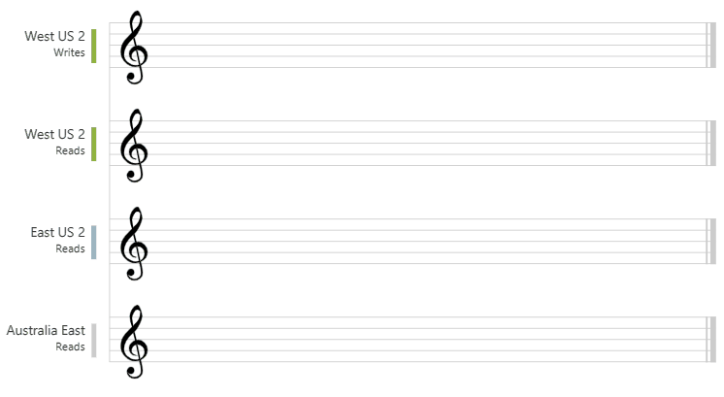
Consistency Levels – Strong
Notes:
Strong consistency offers a linearizability guarantee. Linearizability refers to serving requests concurrently. The reads are guaranteed to return the most recent committed version of an item. A client never sees an uncommitted or partial write. Users are always guaranteed to read the latest committed write.
This graphic illustrates the strong consistency with musical notes. After the data is written to the “West US 2” region, when you read the data from other regions, you get the most recent value..

Slide 99
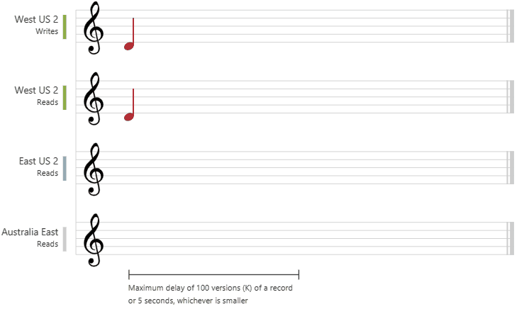
Consistency Levels – Bounded Staleness
Notes:
Bounded stateless: The reads are guaranteed to honor the consistent-prefix guarantee. The reads might lag behind writes by at most “K” versions of an item or by “T” time interval, whichever is reached first.
For a single region account, the minimum value of K and T is 10 write operations or 5 seconds. For multi-region accounts the minimum value of K and T is 100,000 write operations or 300 seconds.
Inside the staleness window, Bounded Staleness provides the following consistency guarantees:
Consistency for clients in the region for an account with single write region = Strong
Consistency for clients in different regions for an account with single write region = Strong
Consistency for clients writing to a single region for an account for an account with multiple write regions = Consistent Prefix
Consistency for clients writing to different regions for an account with multiple write regions = Eventual
Bounded staleness if frequently chosen by globally distributed applications that expect low write latencies but require total global order guarantee. Bounded staleness is great for applications featuring group collaboration and sharing, stock ticker, publish-subscribe/queueing etc.
This graphic illustrates the bounded staleness consistency with musical notes. After the data is written to the “West US 2” region, the “East US 2” and “Australia East” regions read the written value based on the configured maximum lag time or the maximum operations.

Slide 100
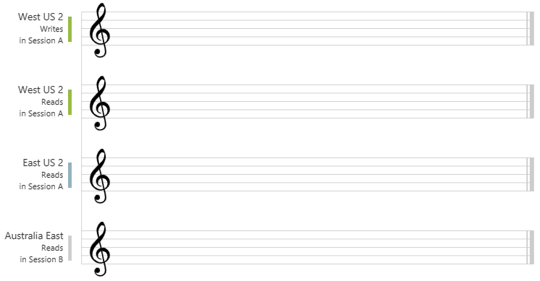
Consistency Levels – Session
Notes:
Session consistency is the most widely used consistency level for both single region as well as globally distributed applications. It provides write latencies, availability, and read throughput comparable to that of eventual consistency but also provides the consistency guarantees that suit the needs of applications written to operate in the context of a user.
This graphic illustrates the session consistency with musical notes. The “West US 2” writer and the “West US 2” reader are using the same session (Session A) so they both read the same data at the time. Whereas the “Australia East” region is using “Session B” so, it receives data later but in the same order as the writes.

Slide 101
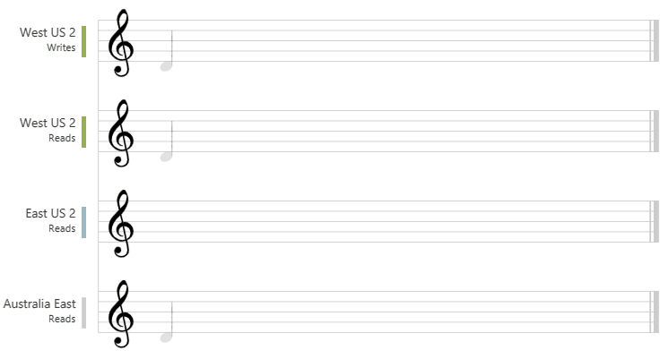
Consistency Levels – Consistent Prefix
Notes:
Consistent prefix: Updates that are returned contain some prefix of all the updates, with no gaps. Consistent prefix consistency level guarantees that reads neve see out-of-order writes.
If writes were performed in the order A/B/C, then a client sees either A, A/B, or A/B/C but never out-of-order permutations like A/C, B/A/C. Consistent Prefix provides write latencies, availability, and read throughput comparable to that of eventual consistency, but also provides the order guarantees that suit the needs of scenarios where order is important.
Consistency guarantees for Consistent Prefix:
Consistency for clients in the same region for an account with single write region = Consistent Prefix
Consistency for clients in different regions for an account with single write region = Consistent Prefix
Consistency for clients writing to a single region for an account with multiple write regions = Consistent Prefix
Consistency for clients writing to multiple regions for an account with multiple write region = Eventual
The graphic illustrates the consistency prefix consistency with musical notes. In all regions, the reads neve see out of order writes.

Slide 102
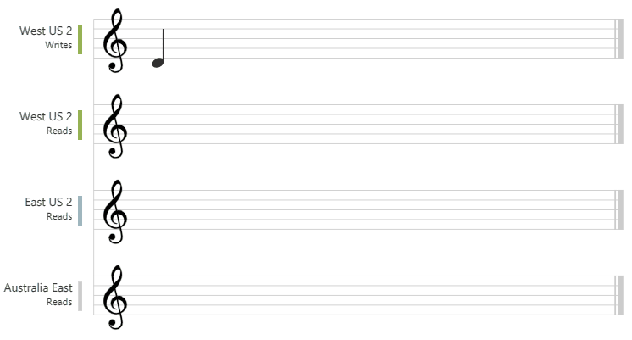
Consistency Levels – Eventual
Notes:
Eventual: There is no ordering guarantee for reads. In the absence of any further writes, the replicas eventually converge.
Eventual consistency is the weakest form of consistency because a client may read the values that are older than the ones it had read before. Eventual consistency is ideal where the application does not require any ordering guarantees. Examples include count of Retweet, Likes, or non-thread comments.
The graphic illustrates the eventual consistency with musical notes.

Slide 103
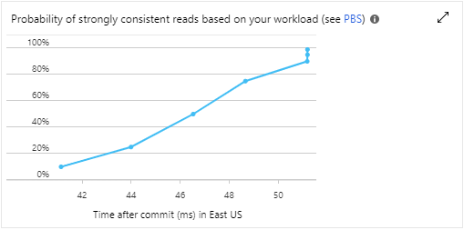
Consistency Guarantees in Practice
Notes:
In practice, you may often get stronger consistency guarantees. Consistency guarantees for a read operation correspond to the freshness and ordering of the database state that you request.
If there are no write operations on the database, a read operation with eventual, session, or consistent prefix consistency level is likely to yield the same results as a read operation with strong consistency level.
If your Azure Cosmos account is configured with a consistency level other than the strong consistency, you can find out the probability that your clients may get strong and consistent reads for your workloads by looking at the Probabilistically Bounded Staleness (PBS) metric.
Probabilistic bounded staleness shows how eventual is your eventual consistency. This metric provides an insight into how often your can get a stronger consistency than the consistency level that you have currently configured on your Azure Cosmos account. In other words, you can see the probablility (measured in milliseconds) of getting strongly consistent reads for a combination of write and read regions.

Slide 104


Slide 105
Service Quotas – Provisioned Throughput
Resource | Default Limit
Maximum RUs per container | 1,000,000 (by default)
Maximum RUs per database | 1,000,000 (by default)
Maximum RUs per (logical) partition | 10,000
Maximum storage across all items per (logical) partition | 20-Gb
Maximum number of distinct (logical) partition keys | Unlimited
Maximum storage per container | Unlimited
Maximum storage per database | Unlimited
Minimum RU/s required pre 1-Gb | 10 RU/s
Notes:
A Cosmos container (or shared throughput database) must have a minimum throughput of 400 RU/s. As the containers grows, the minimum supported throughput also depends on the following factors:
The maximum throughput ever provisioned on the container. For example, if your throughput was increased to 50,000-RU/s, then the lowest possible provisioned throughput would be 500 RU/s.
The current storage in GB in the container. For example, if your container has 100-Gb of storage, then the lowest possible provisioned throughput would be 1000 RU/s.
The minimum throughput on a shared throughput database also depends on the total number of containers that you have ever created in a shared throughput database, measured at 100 RU/s per container. For example, if you have created five containers within a shared throughput database, then the throughput must be at least 500 RU/s.

Slide 106
Service Quotas – Serverless
Resource | Default Limit
Maximum RU/s per container | 5,000
Maximum RU/s per (logical) partition | 5,000
Maximum storage across all items per (logical) partition | 20-Gb
Maximum number of distinct (logical) partition keys | Unlimited
Maximum storage per container | 50-Gb

Slide 107
Service Quotas – Per-Account Limits
Resource | Provisioned Throughput | Serverless
Maximum number of databases | Unlimited | Unlimited
Maximum number of containers | Unlimited per account 25 per database | 100 per account
Maximum number of regions | No limit (All Azure regions) | 1 (Any Azure region)

Slide 108
Service Quotas – Per-Item Limits
Resource | Default Limit
Maximum size of an item | 2-MB
Maximum length of partition key value | 2048 bytes
Maximum length of ID value | 1023 bytes
Maximum number of properties per item | No practical limit
Maximum length of property name | No practical limit
Maximum length of property value | No practical limit
Maximum length of string property value | No practical limit

Slide 109
Service Quotas – Per-Request Limits
Resource | Default Limit
Maximum execution time for single operation | 5 Seconds
Maximum request size | 2-Mb
Maximum response size | 4-Mb
Maximum number of operations in a transaction batch | 100
Notes:
Maximum execution time for a single operation (like a stored procedure execution or single query page retrieval)
Maximum request size (for example, stored procedure, CRUD)
Maximum response size (for example, paginated query)

Slide 110
Service Quotas – Try Cosmos DB Free Limits
Resource | Default Limit
Duration of the trial | 30 days
Maximum containers per subscription | 1 (SQL, Gremlin, Table) 3 (MongoDB)
Maximum throughput per container | 5,000
Maximum throughput shared-throughput database | 20,000
Maximum total storage per account | 10-Gb
Notes:
Duration: 30-days (a new trial can be requested after expiration). After expiration, the information stored is deleted.
Try Cosmos DB supports global distribution in only the Central US, North Europe, and Southeast Asia regions.

Slide 111
Service Quotas – Free Tier Account Limits
Resource | Default Limit
Number of free tier accounts per Azure subscription | 1
Duration of free-tier discount | Lifetime of the account
Maximum RU/s for free | 400 RU/s
Maximum storage for free | 5-Gb
Maximum number of shared throughput databases | 5
Maximum number of containers in a shared throughput database | 25

Slide 112


Slide 113
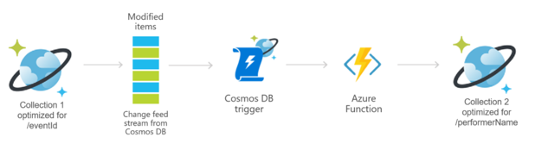
Change Feed
Notes:
The change feed listens to an Azure Cosmos container for any changes. It then outputs a sorted list of documents that were changed in the order in which they were modified. The changes are persisted, can be processed asynchronously and incrementally, and the output can be distributed across one or more consumers for parallel processing.

Slide 114
Change Feed
Enabled by default
Notes:
Change feed is enabled by default for all Azure Cosmos accounts
You use the provisioned throughput to read from the change feed, just like any other Azure Cosmos DB operation, in any of the regions associated with your Azure Cosmos database.

Slide 115
Change Feed
Enabled by default

Slide 116
Change Feed
Enabled by default
Includes insert and update operations
Notes:
The change feed includes inserts and update operations made to items within the container.
You can capture deletes by setting a “soft-delete” flag within your documents in place of deletes.
Alternatively, you can set a finite expiration period for your items with the TTL capability.

Slide 117
Change Feed
Enabled by default
Includes insert and update operations

Slide 118
Change Feed
Enabled by default
Includes insert and update operations
Each change appears exactly once
Notes:
Each change to an item appears exactly once in the change feed

Slide 119
Change Feed
Enabled by default
Includes insert and update operations
Each change appears exactly once

Slide 120
Change Feed
Enabled by default
Includes insert and update operations
Each change appears exactly once
Clients manage checkpointing logic
Notes:
And the clients must manage the checkpointing logic.
If you want to avoid the complexity of managing checkpoints, the change feed processor provides automatic checkpointing and “at least once” semantics.

Slide 121
Change Feed
Enabled by default
Includes insert and update operations
Each change appears exactly once
Clients manage checkpointing logic

Slide 122
Change Feed
Enabled by default
Includes insert and update operations
Each change appears exactly once
Sorted by order of modification
Clients manage checkpointing logic
Notes:
The change feed is sorted by the order of modification within each logical partition

Slide 123
Change Feed
Enabled by default
Includes insert and update operations
Each change appears exactly once
Sorted by order of modification
Clients manage checkpointing logic

Slide 124
Change Feed
Enabled by default
Includes insert and update operations
Each change appears exactly once
No guaranteed order of logical partitions
Clients manage checkpointing logic
Sorted by order of modification
Notes:
There is no guaranteed order across the partitions.

Slide 125
Change Feed
Enabled by default
Includes insert and update operations
Each change appears exactly once
No guaranteed order of logical partitions
Clients manage checkpointing logic
Sorted by order of modification

Slide 126
Change Feed
Enabled by default
Includes insert and update operations
Each change appears exactly once
Synchronized from any point-in-time
Clients manage checkpointing logic
Sorted by order of modification
No guaranteed order of logical partitions
Notes:
Changes can be synchronized from any point-in-point, that is there is no fixed data retention period for which changes are available.

Slide 127
Change Feed
Enabled by default
Includes insert and update operations
Each change appears exactly once
Synchronized from any point-in-time
Clients manage checkpointing logic
Sorted by order of modification
No guaranteed order of logical partitions

Slide 128
Change Feed
Enabled by default
Includes insert and update operations
Each change appears exactly once
Changes available in parallel for logical partitions
Clients manage checkpointing logic
Sorted by order of modification
No guaranteed order of logical partitions
Synchronized from any point-in-time
Notes:
Changes are available in parallel for all logical partition keys of an Azure Cosmos container.
This capacity allows changes from large containers to be processed in parallel by multiple consumers.

Slide 129
Change Feed
Enabled by default
Includes insert and update operations
Each change appears exactly once
Changes available in parallel for logical partitions
Clients manage checkpointing logic
Sorted by order of modification
No guaranteed order of logical partitions
Synchronized from any point-in-time

Slide 130
Change Feed
Enabled by default
Includes insert and update operations
Each change appears exactly once
Applications can request multiple change feeds
Clients manage checkpointing logic
Sorted by order of modification
No guaranteed order of logical partitions
Synchronized from any point-in-time
Changes available in parallel for logical partitions
Notes:
Applications can request multiple change feeds on the same container simultaneously.
ChangeFeedOptions.StartTime can be used to provide an initial starting point.
For example, to find the continuation token corresponding to given clock time. The ContinuationToken, if specified, takes precedence over the StartTime and StartFromBegininning values. The precision of ChangeFeedOptions.StartTime is ~ 5 seconds.

Slide 131
Change Feed Options
Change Feed Processor
Azure Function

Slide 132


Slide 133


